Slide 1
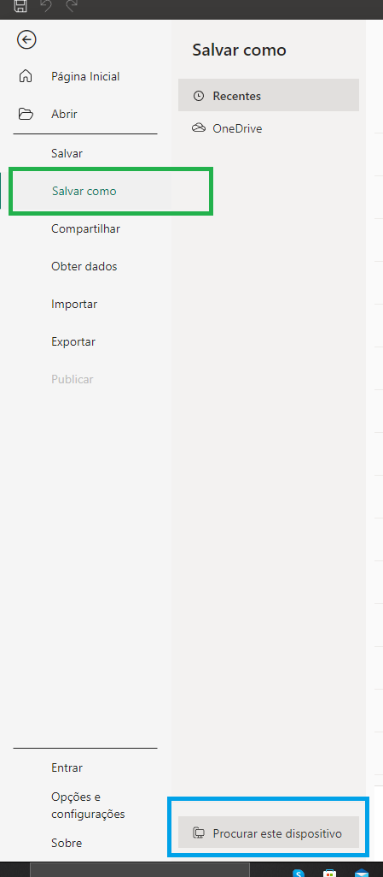
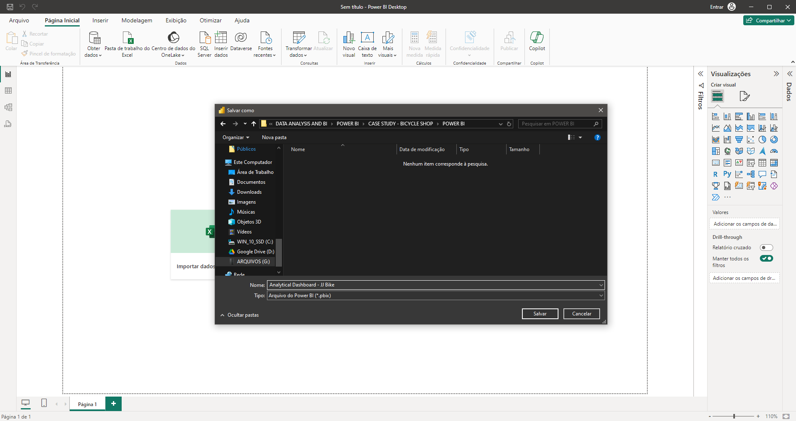
Documentation Dashboard Power Bi - JJ Bike
First we open Power BI and save the Dashboard. Follow these steps:
Below, in the green highlight, click the "Save As" button.
And in the blue highlight click on “Search this device” and choose a location where you will place your file and give it a name and click save.
Now we have an empty Dashboard to work with.

Slide 2
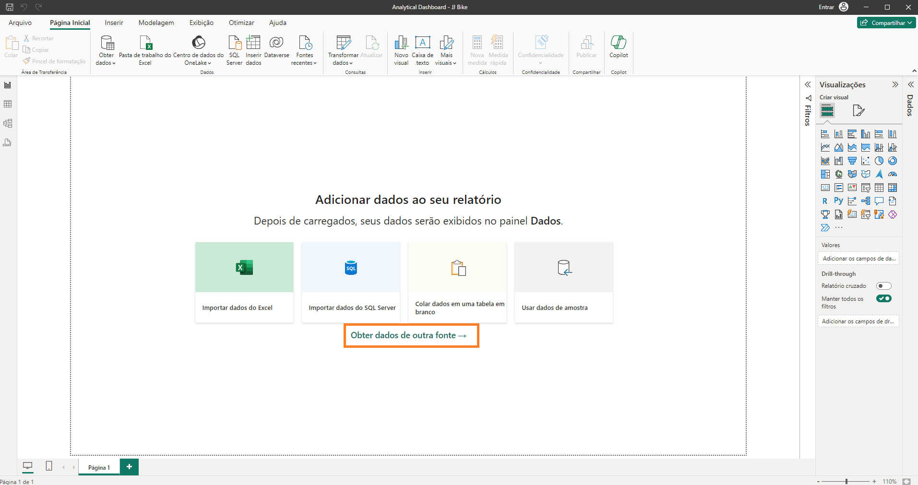
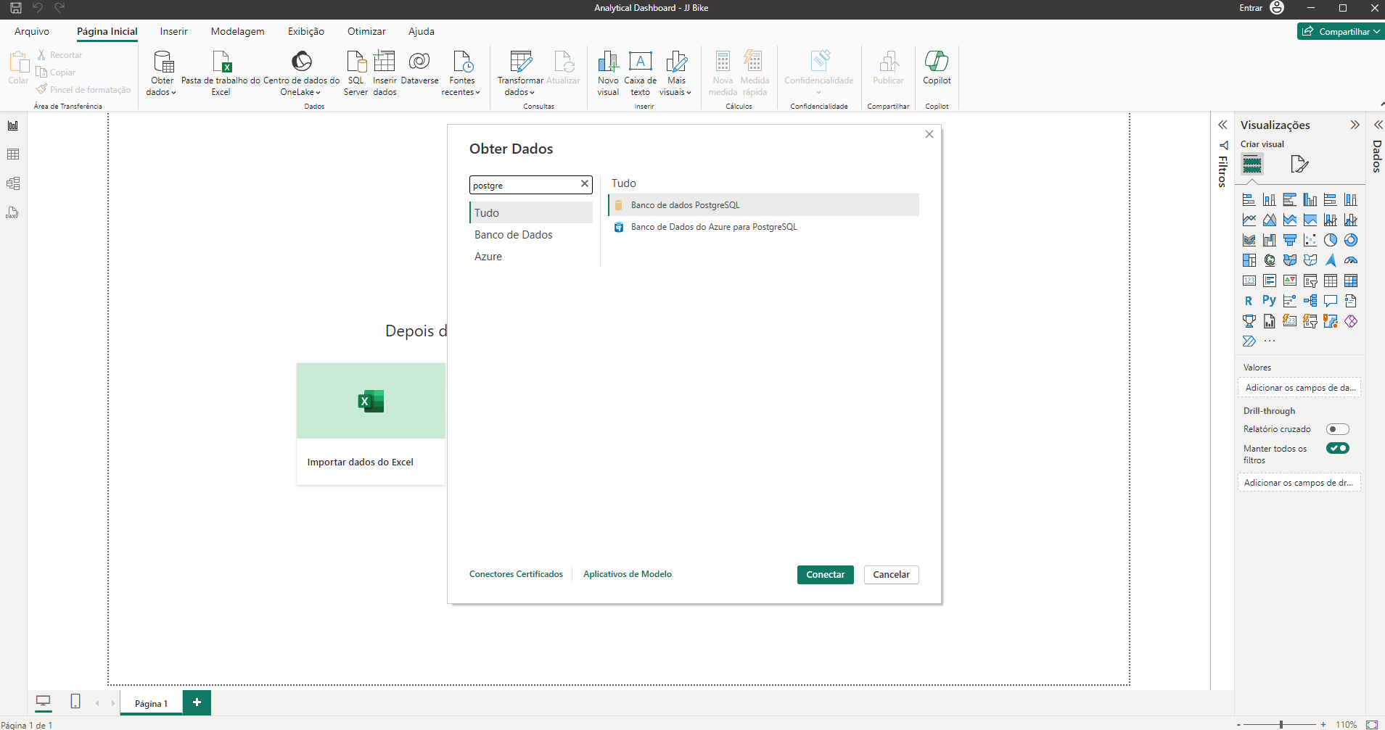
Documentation Dashboard Power Bi - JJ Bike
Connecting to the PostGree database
To connect to the PostGree database, we need to follow this example below: Click on highlight orange, it will open a new window
Bellow you need just search postgree and click in the correspondent result, select "database PosgreeSQL" and click in button green Connect

Slide 3
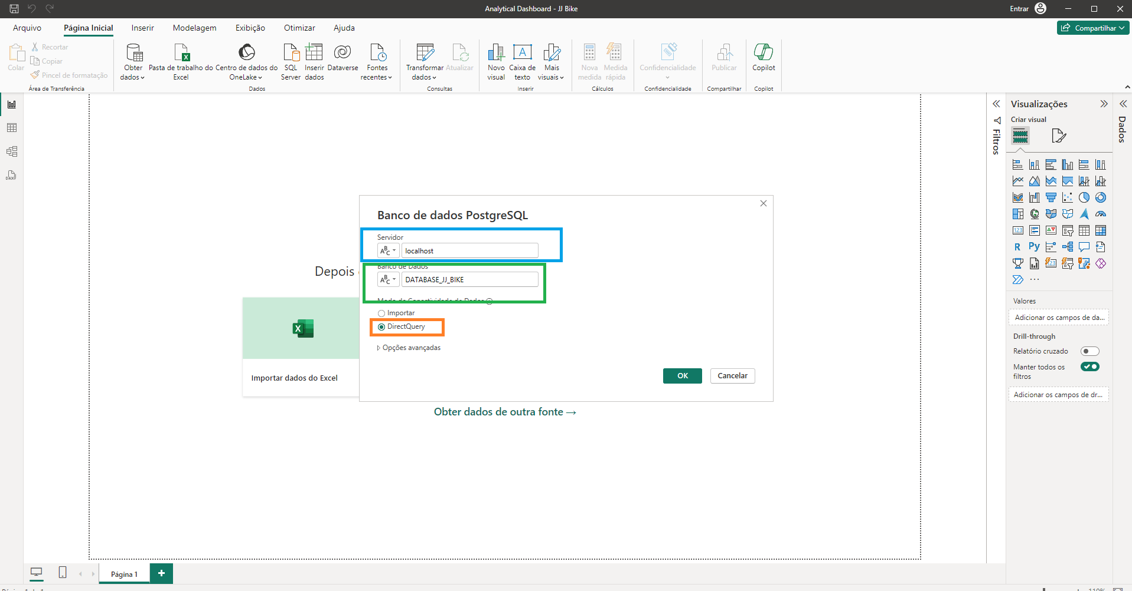
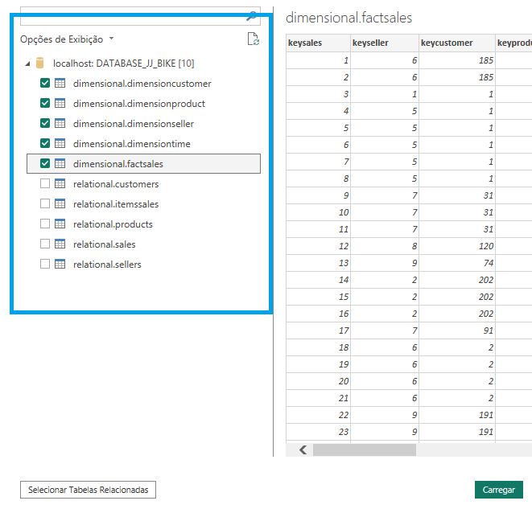
Documentation Dashboard Power Bi - JJ Bike
No destaque azul, aqui temos que selecionar o nome e a localização do servidor postgre hospedado, neste caso está na máquina local, então usamos "localhost“.
In the green highlight, here we put the name of the database, in this case it is called : DATABASE_JJ_BIKE
In the orange highlight, here we select the "Direct Query" option because we develop queries connected directly to the database, it is not a simple import of data, but this connection allows us to update immediately when we execute the command for update.
After that, Power BI will ask for the PostGre database username and password, just enter the credentials and you will connect to the database.

Slide 4
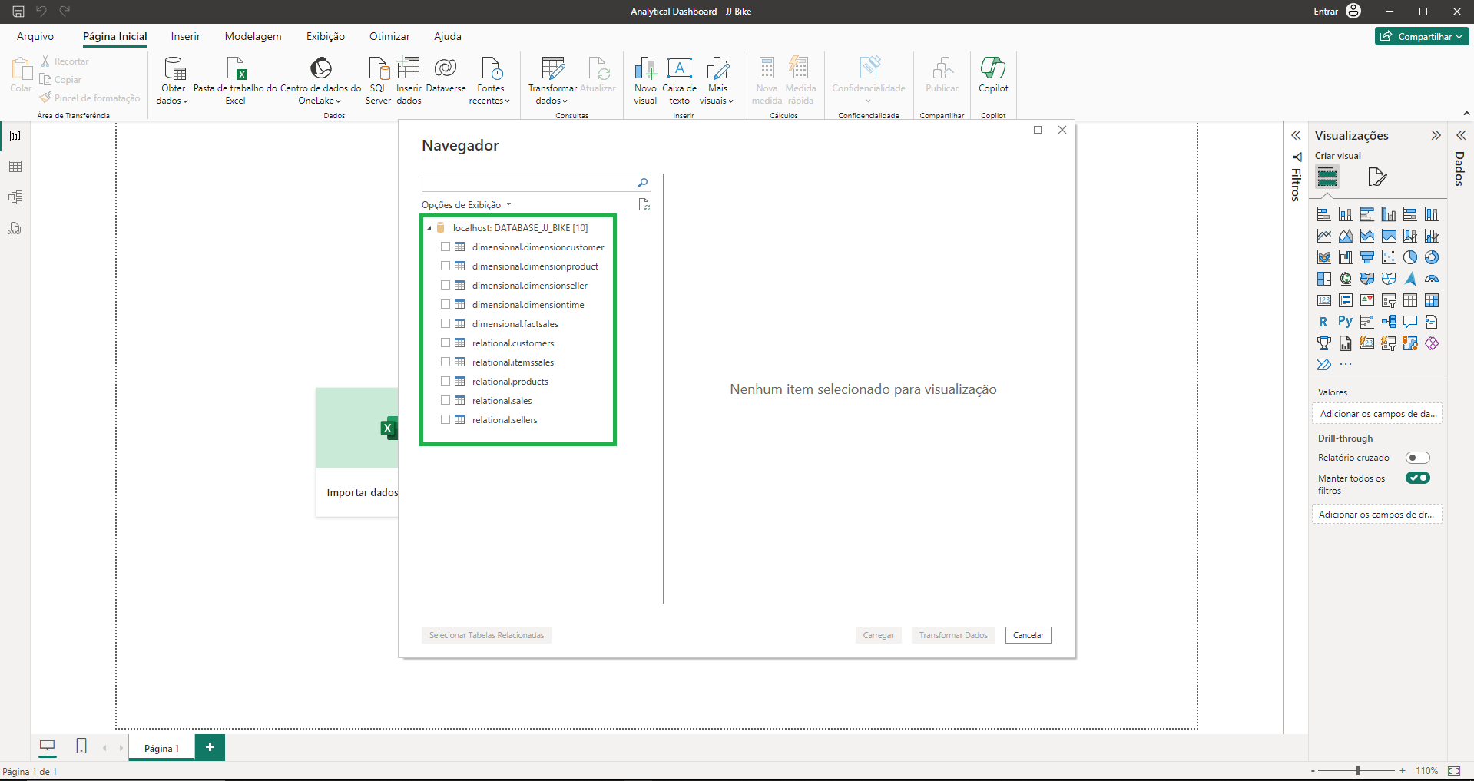
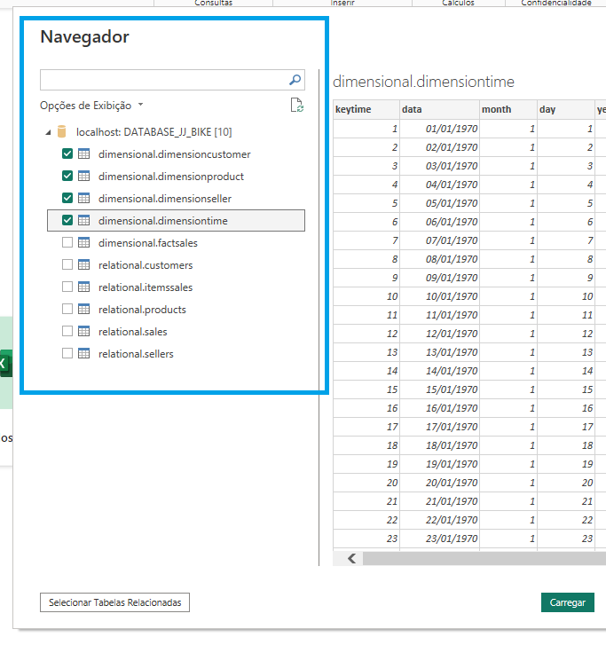
Below, in green highlight, we can see all the existing tables in the Postgre Database, the Relational Schema and the Dimensional Schema.
Documentation Dashboard Power Bi - JJ Bike
Below the tables that we will use in the construction of our dashboard have been selected. Note that only the dimensional model tables were selected as these tables belong to our Data Warehouse built exclusively for the development of Dashboards and Reports.
Click the green “Load” button and all selected tables will be loaded into the Dashboard.
In the real situation, the company does not allow you to connect directly to the transactional database so as not to compete with the transactional system, but it is common to have a mirror of this database to make queries.

Slide 5
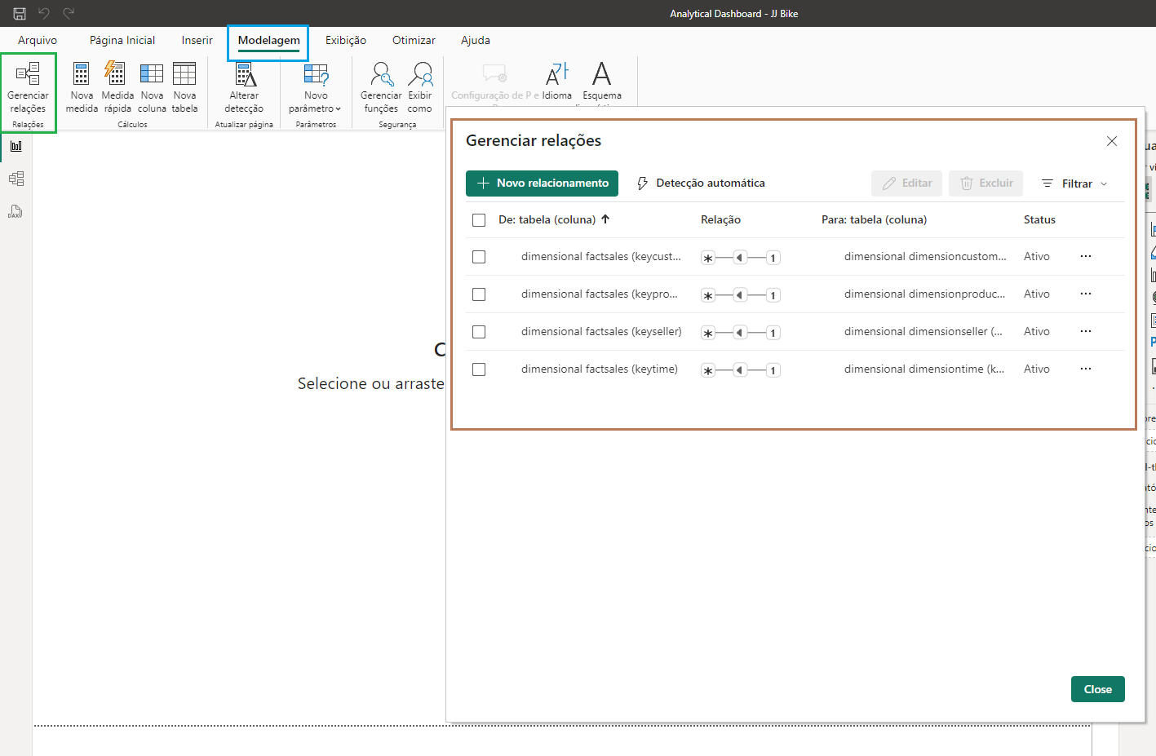
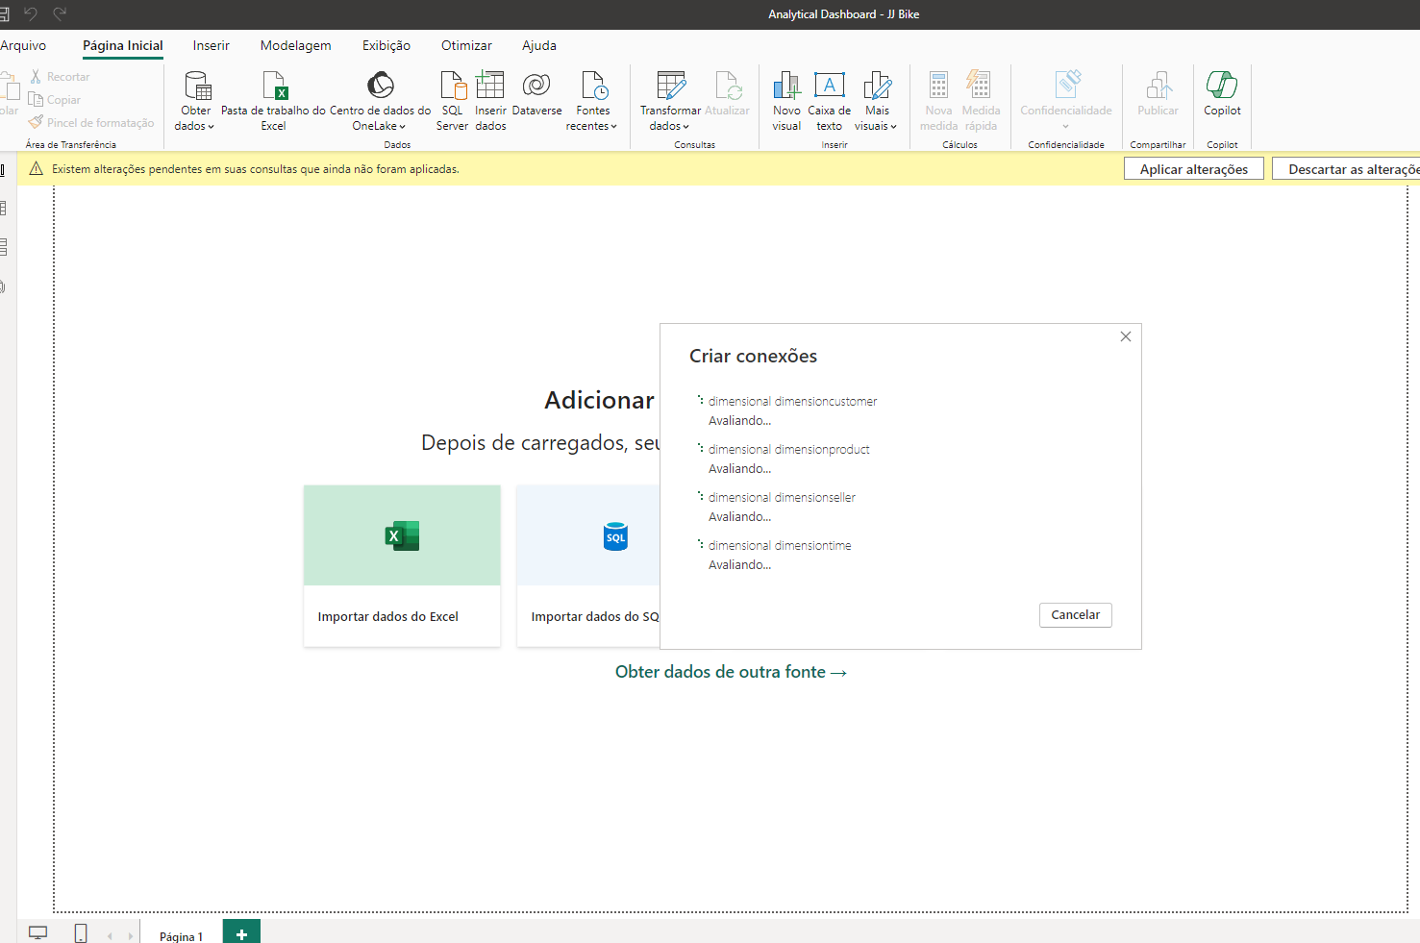
After the tables are finished loading, we need to take a look at data modeling. Shown below: To access data modeling we click on the blue highlight in "Modeling" . Then click on the green highlighted button in “management relationships”. The brown highlighted window will open. This is the relationship automatically detected by Power BI, after analysis we concluded that this relationship is correct. The close button was clicked to close this window.
Documentation Dashboard Power Bi - JJ Bike
Loading Tables In Power BI
Below we can see the tables being loaded within the Dashboard

Slide 6
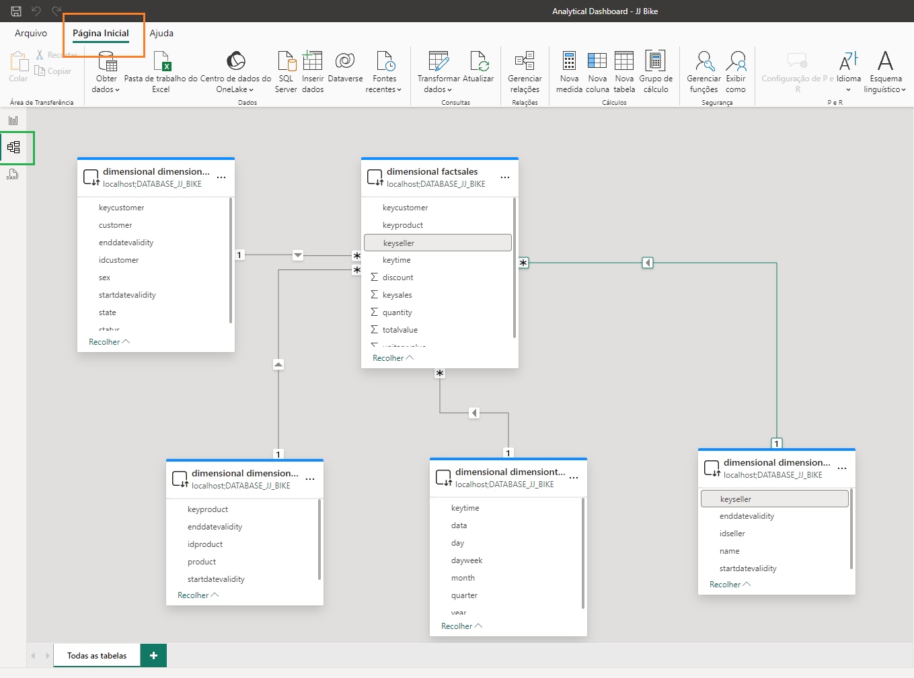
To access this window, we click on “Begin Page” highlighted in orange.
Documentation Dashboard Power Bi - JJ Bike
Data Modeling In Power BI
Then we click on the Blue highlighted icon. No lado esquerdo podemos ver a relação visual entre as tabelas, ao clicarmos na linha que liga uma tabela à outra podemos ver a chave em ambas as tabelas destacadas em cinza.

Slide 7
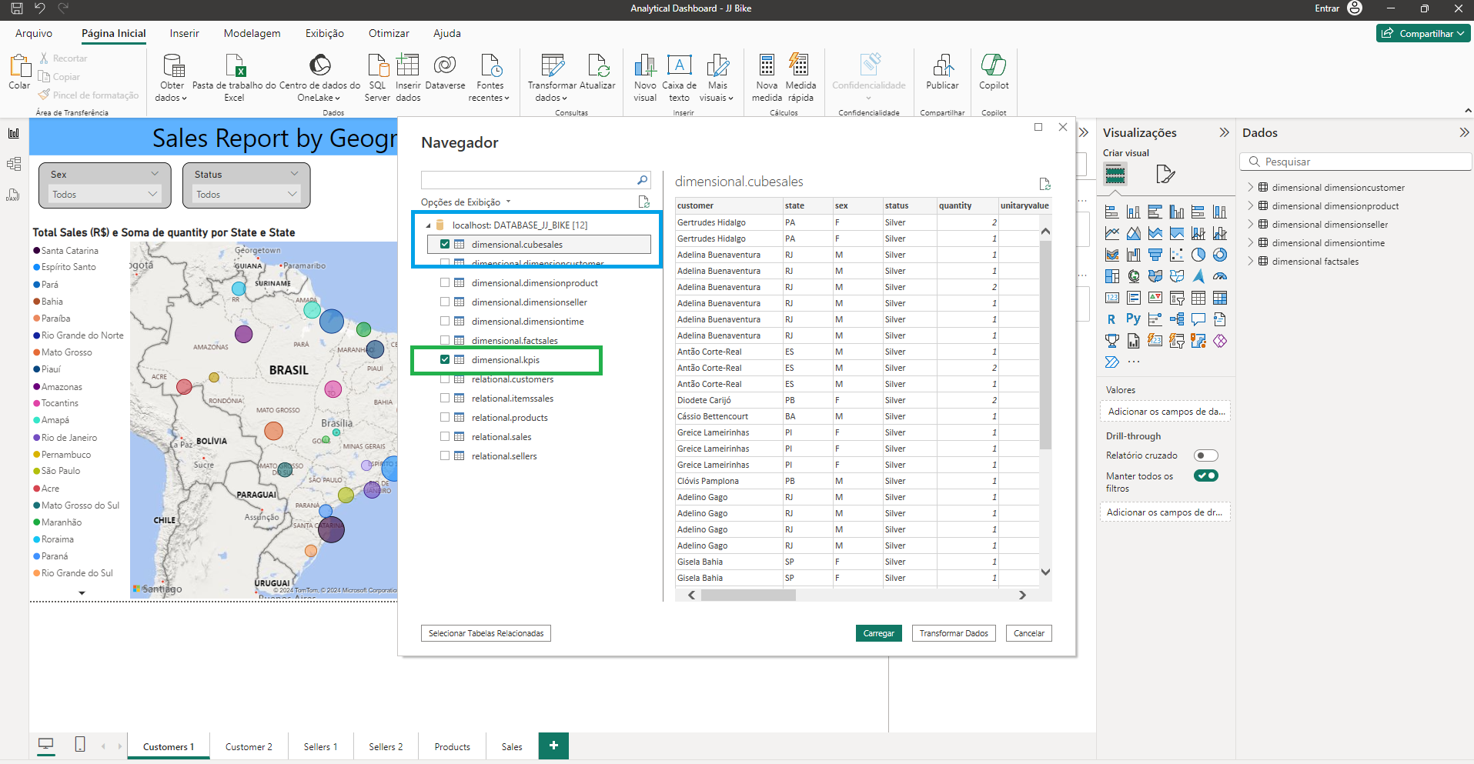
On the left side we can see two new tables added in Power BI, the dimensional.cubesales table and the dimensional.kpis table, these two tables will not be connected in the data model in Power BI as they have summarized data and this data has a specific level of summary, unlike the data model, in this case these tables are built only for use at this level and do not require any other connection with any other table. And their eventual connection with tables with low levels of granularity can generate duplication in the data in the data model, which is why they are not connected to the model and are used in isolation.
Documentation Dashboard Power Bi - JJ Bike
Adding Ad Hoc Tables Outside Data Modeling in Power BI

Slide 8
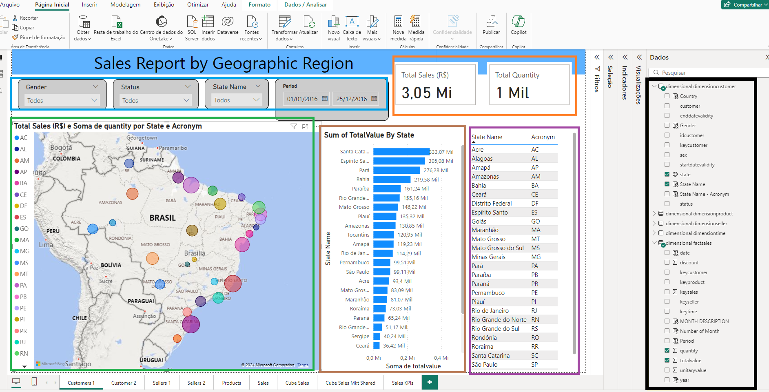
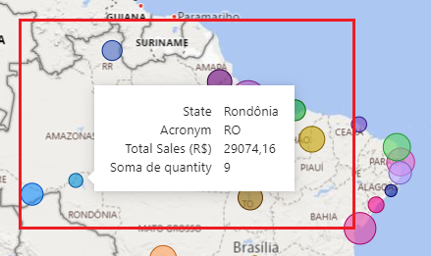
Report : Sales Report by Geographic Region
Below we have the First Report in the first tab “Cusrtomer 1” this report is called “Sales Report by Geographic Region” its function is to give a view of total sales in values ​​and quantity throughout Brazil.
In the blue highlight we have some filters: Gender which is Male and Female this is the customer information, Status whose options are Golden, Platinum and Silver this is a class of the company's reward program for its customers, Period which is a range of dates beginning and end of sales occurred.
Highlighted in Orange, we have the total sales value and the Total Sales Quantity, these values ​​will change if any filter is applied and this change will show the result for these specific filters.
In the green highlight we can see the Map of Brazil with Total Sales and Total Quantity per state spread across the country, the size of the bubble is determined by total sales, the higher the total, the bigger the bubble.
In the brown highlight we can see the Bar Chart with the total value per state organized from highest value to lowest value.
In the purple highlight we can see the list of Brazilian states with their acronyms, this list can be used to apply filters directly to them as well.
In highlight black we can see the tables used in this visualization in this case is used two mainly tables "dimensional dimension customer" and "dimensional fact sales“.
In the red highlight we can see the tooltips shown when the person hovers the mouse pointer above the bubbles, they show the total value and amount of sales for the bubbles in each state

Slide 9
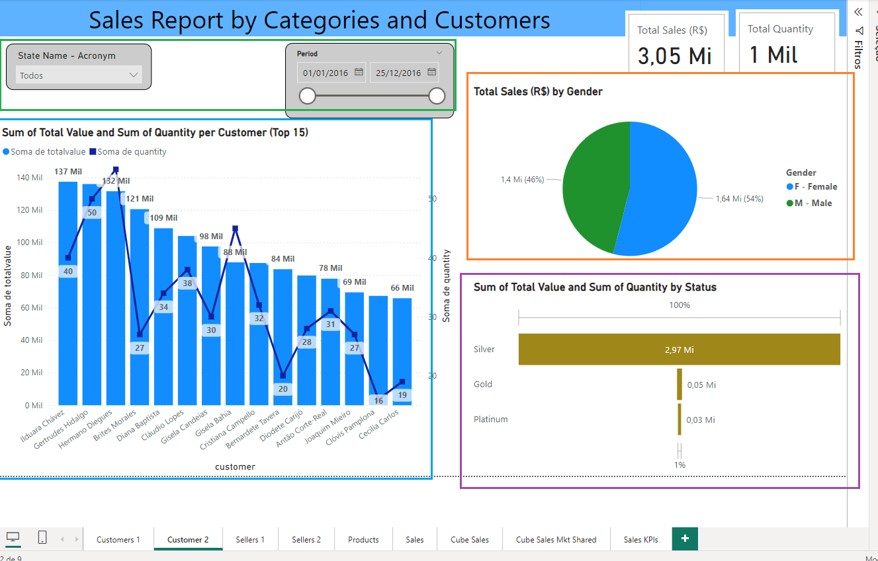
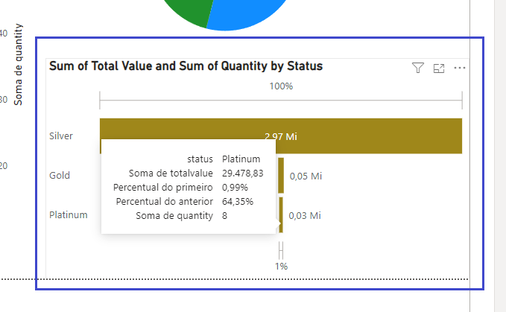
Report : Sales Report by Categories and Customers
This is the second Customer Sales Report in tab two called “Customer 2” with the name “Sales Report by Categories and Customers”.
In the green highlight we can see two Filters, the first is the acronym for all states in Brazil, the second is the period of time in which sales occurred.
In the blue highlight we can see the graphs, in the bars we have the total monetary value of sales and in the line we have the total amount of sales by Top 15 customers organized by the total monetary value from highest to lowest.
In the orange highlight we can see the pie chart by male and female gender by total monetary value
In the purple highlight we can see the bar graph by Status which are Silver, Gold and Platinum by Total Value shown in the Bars.
In the dark blue highlight bellow we can see tooltips with the sum of the total value and quantity and some percentage calculations done automatically.

Slide 10
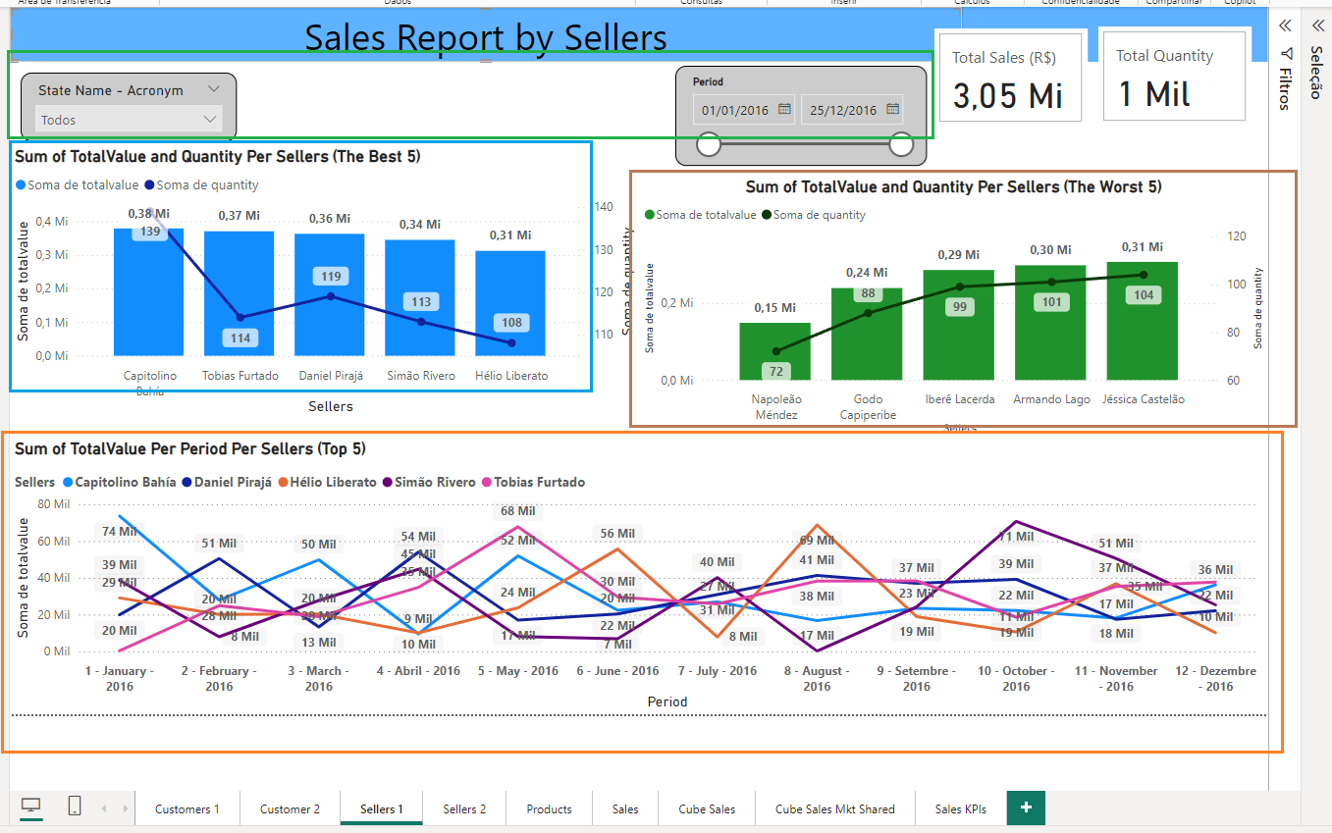
Report : Sales Report by Sellers
This is a first sellers report in the third tab called "Sellers 1" the report is a "Sales by sellers report“.
In green highlight we have the filters, by Brazilian State Acronym and by Period of the sales date.
In the blue highlight we have the graph, in the bars we have the sum of the Total Value and in the Line we have the sum of the quantity by the first five Sellers who sold the most, organized by the sum of the Total Value from highest to lowest.
In the brown highlight we can see that the graph has the same information as the blue highlight with a single difference, here it shows the five sellers have the worst results, the data is ordered from the worst seller to the best seller
In the orange highlight we can see the graph of lines called time series.
In this case, the five best sellers who sold and their results per month are shown. The measure used is the sum of the Total Value.

Slide 11
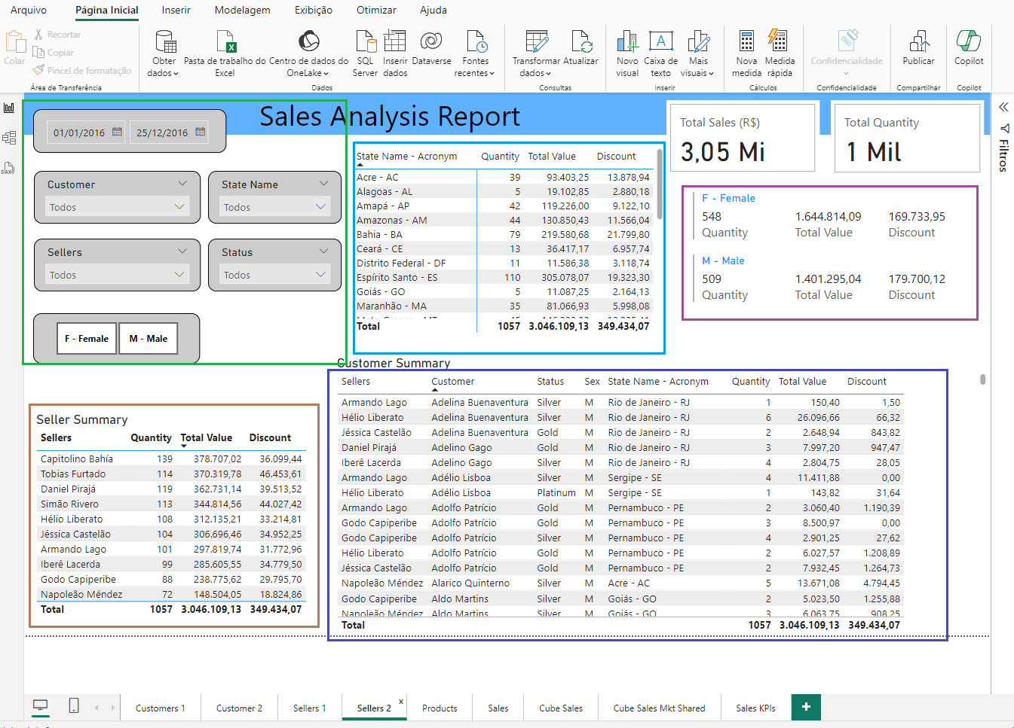
Report : Sales Analysis Report
This is a first sellers report in the third tab called "Sellers 2" the report is a "Sales Analysis Report“.
In green highlight, we can see the filters, Filter by Sales Period, Filter by Customer Name, Filter by State of the Country Brazil, Filter by Name of Sellers, Filter by Status of the classification of the rewards program for customers and Filter by Gender Female or Male.
In light blue we can see the name of the State of Brazil with its acronyms and the sum of the Sales Quantity, Total Value and Discount measures.
In Purple Highlight we can see the Female and Male Gender Field with the sum of measurements, quantity, Total Value and Discount.
In brown Highlight we can see the Seller Field with the sum of measurements, quantity, Total Value and Discount.
In dark blue Highlight we can see the Fields Sellers, Customer with the sum of measurements, quantity, Total Value and Discount.

Slide 12
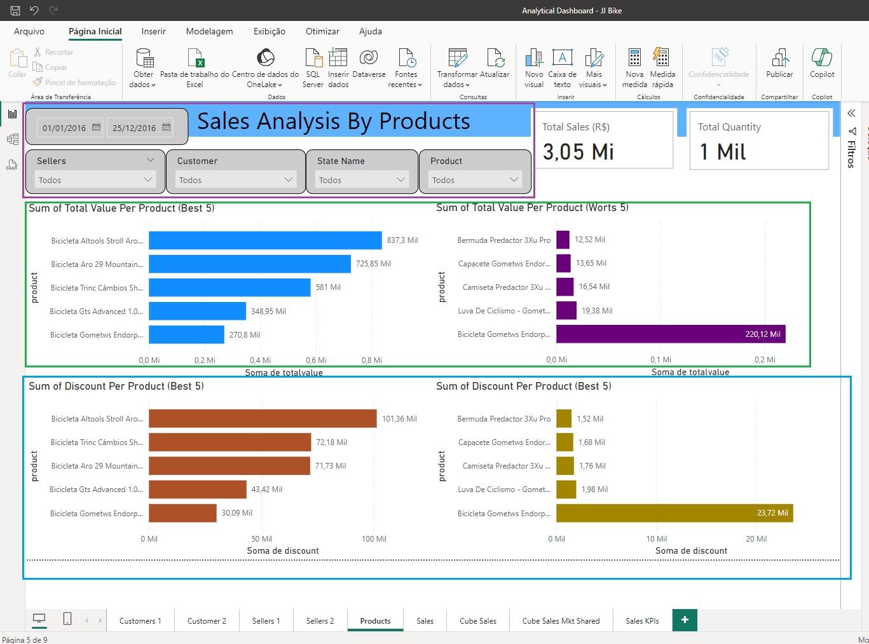
Report : Analysis By Products
This is a product report in the fifth tab called “Products”. The report is called “Analysis by Products”.
In purple highlight, we can see the filters, Filter by Sales Period, Filter by Sellers Name, Filter by Customer Name, Filter by State of the Country Brazil, Filter by Name of Product.
In green hightlight, we can see the graphs by product field using the Sum of Total Value measure.
In the blue bars, we have the five best products with the most sales.
In the purple bars, we have the five worst products with the lowest sales results.
In blue, we can see the charts by product field using the Sum of Discount measure.
In the brown bars, we have the five best-selling products with the highest discounts.
In the gold bars, we have the five worst-selling products with the lowest discounts.

Slide 13
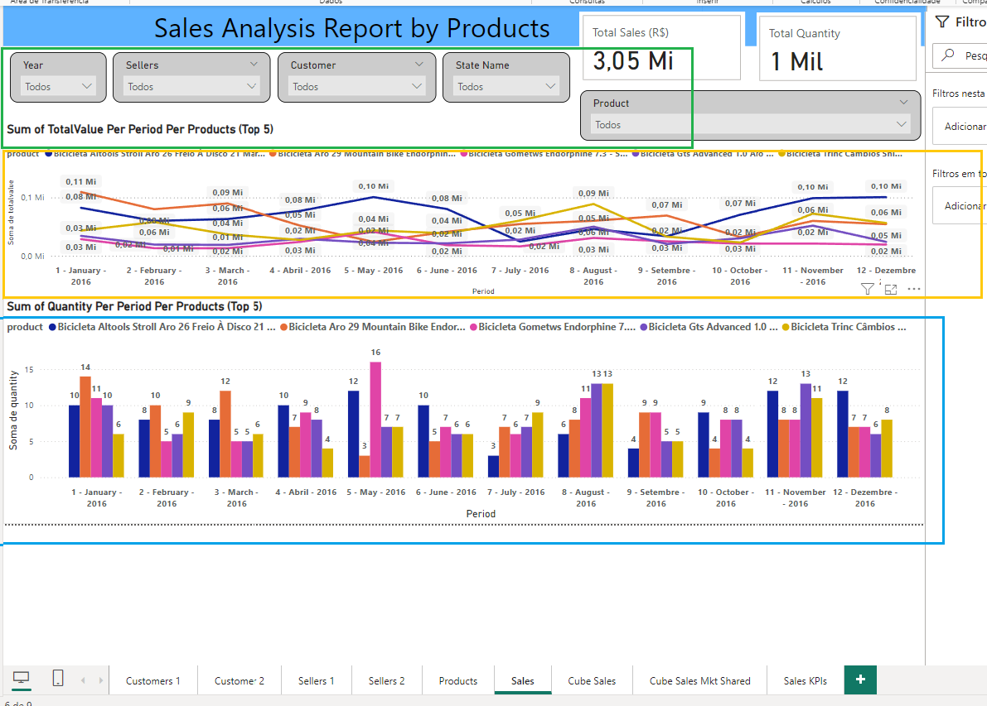
Report : Sales Analysis Report by Products
This is a product sales report in the sixth tab called “Sales”. The report is called “Sales Analysis Report by Products”.
In green highlight, we can see the filters, Filter by Year Period, Filter by Seller Name, Filter by Customer Name, Filter by State of the Country Brazil, Filter by Product Name.
In orange highlight, we have the five products with the most sales per month, whose measure is Total Value in a time series line chart.
In blue highlight, we have the five products with the most sales per month, whose measurement is the Sum of quantities in a bar graph grouped by products

Slide 14
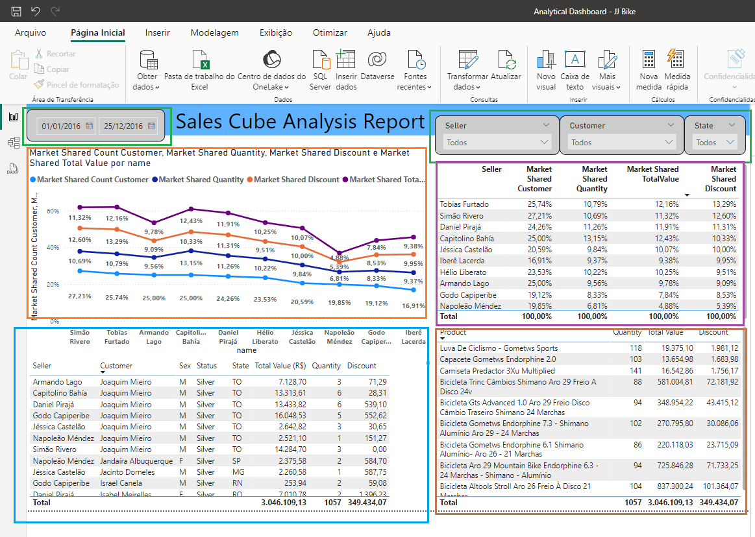
Report : Sales Cube Analysis Report
This is a sales analysis report and it is in the seventh tab called “Cube Sales”. The report is called “Sales Cube Analysis Report”. This report is based on a single table called “dimensional cubesales”. This table is designed for use in Dashboards and has summarized data and contains all the fields and transactional data for main analysis, due to this, this table is used individually and has no link with other tables.
In green highlight, we can see the filters, Filter by Period of date , Filter by Seller Name, Filter by Customer Name, Filter by State of the Country Brazil.
In the orange highlight, we can see the line graph showing the results by sellers in percentage, this is a calculated metric, the calculation is done by dividing the individual value of each seller by the total value which is called participation, that is, the result of each seller is compared with the total result and thus defined how much in percentage each seller had in relation to the total result, for the following measures: Number of Customers, Number of Products Sold, Discount by Products and Total Value of sales of the products of each seller.
In the blue highlight, we can see the table with the fields, seller, customer, gender, Status and State the measures are the sum of the Total Value, Quantity and Discount.
In the purple highlight, we can see the table with the seller field with all the percentage values ​​for the metrics Market Shared Count Customer, Market Shared Quantity, Market Shared Total Value and Market Shared Discount.
In the brown highlight, we can see the table with the product field whose measurements are the sum of Quantity, Total Value and Discount.

Slide 15
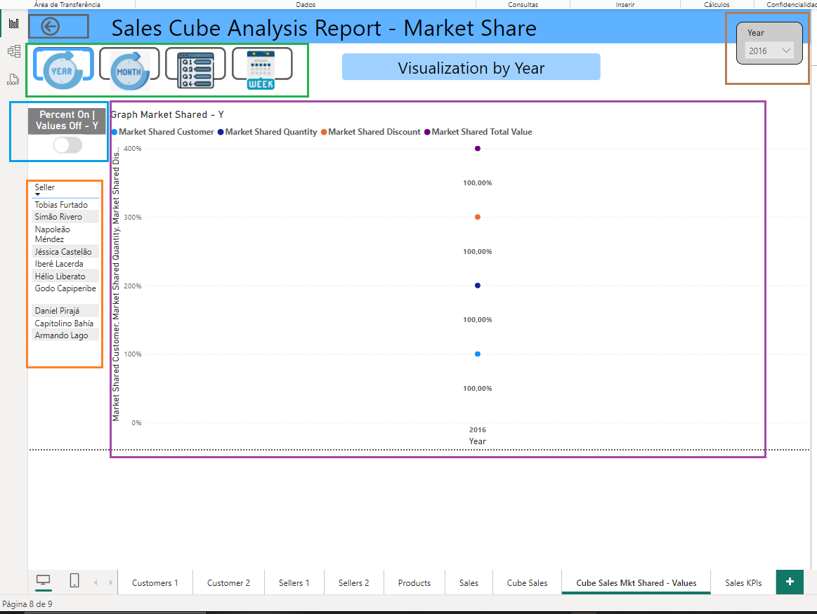
Report : Sales Cube Analysis Report - Market Share - YEAR
This is a sales analysis report and it is in the eighth tab called “Cube Sales Mkt Shared or Values”. The report is called “Sales Cube Analysis Report (Market Shared | Values)”. This report has two views, one is percentage based and the other is value based, we can change the view in a button in each segment by time period: year, month, quarter and week.
This is an annual view by market share based on the metrics of market share count by customer, market share quantity, total market share value, and market share discount.
This is the year view, when you click on the YEAR icon it is highlighted in blue and information about the selected year is displayed.
In green, we have four icons for clicking access to the view data, by Year, by Month, by Quarter and by Week.
In brown highlight we have the filter by year, in this case we only have one year in the database for now.
In the Blue Highlight we have a button to access the other view by year based on values.
In orange we have the list of all sellers and it can be used to select a seller and see their result by year.
In the purple highlight, we can see the line chart by year based on time series, but we have only one year, due to this, we have only one data point, but if we put more years, the line will be drawn between those years. This chart is based on the four participation metrics.

Slide 16
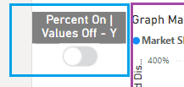
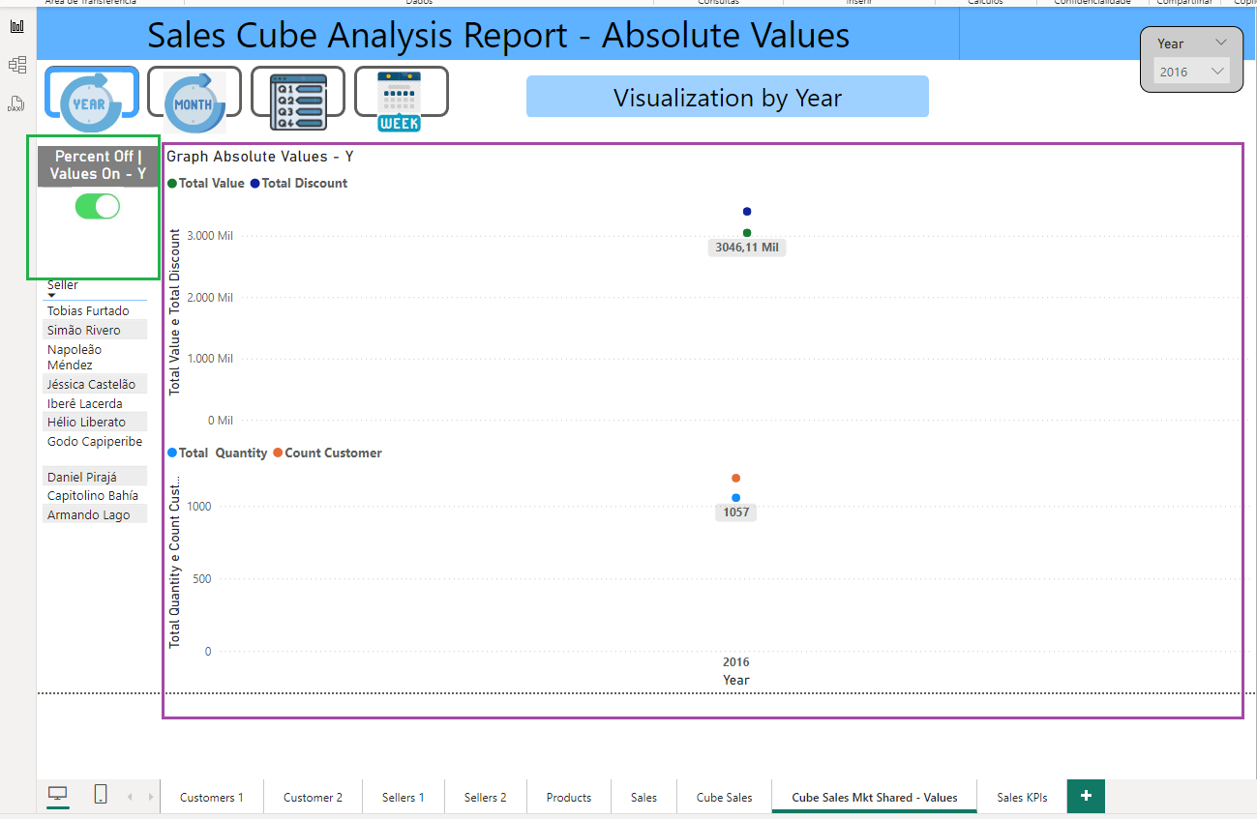
Report : Sales Cube Analysis Report – Absolute Values - YEAR
This is an annual view by Values
When the button highlighted in blue is clicked, you will have access to another view of the year, but by value.
This view bellow , based in Absolute Values
Clicking the button highlighted in green will return to the previous view based on market share.
In brown we have two line graphs based on time series, the first based on the sum of the Total Value and Total Discount metrics and the second graph based on Total Quantity and Customer Count. As the scale is very different, in the first one there are high values ​​and in the second one there are low values, to visualize these two pieces of information they have to be separated into two distinct graphs, if we put all the metrics together in the same graph the low values ​​will not appear in the graph.

Slide 17
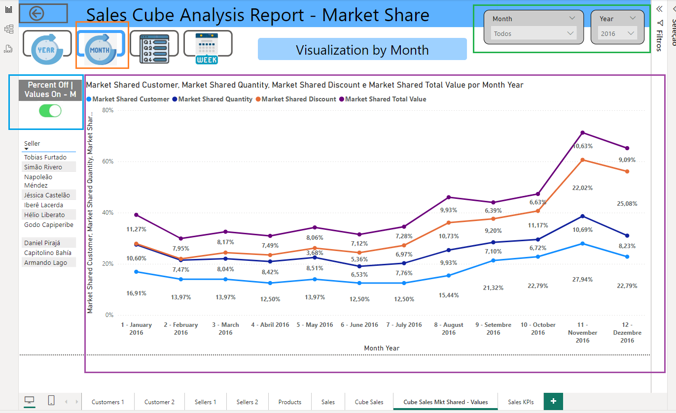
Report : Sales Cube Analysis Report - Market Share - MONTH
This report follow the same structure the report year , with only one difference is open per Month instead by year.
In the orange highlight we can see that the currently selected icon is the Monthly View.
In the green highlight we can see the filters by Month and Year.
In the blue highlight we can see the button that takes us to the view of absolute values ​​per Month.
This graph shown the Month view by market share based on the metrics of market share count by customer, market share quantity, total market share value, and market share discount.

Slide 18
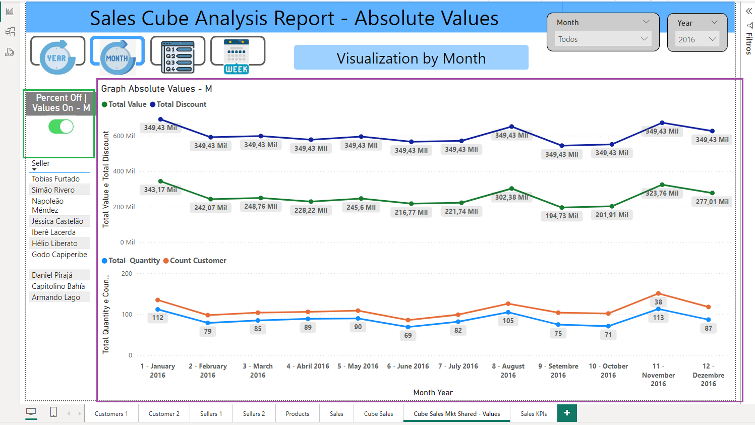
Report : Sales Cube Analysis Report – Absolute Values - MONTH
This report follow the same structure the report year , with only one difference is open per Month instead by year.
In green highlight we can see the button that takes us back to the Monthly view by market share.
In purple highlight, we have a visualization similar to the absolute value visualization by year, with only one single difference, it is opened by Month instead of year.

Slide 19
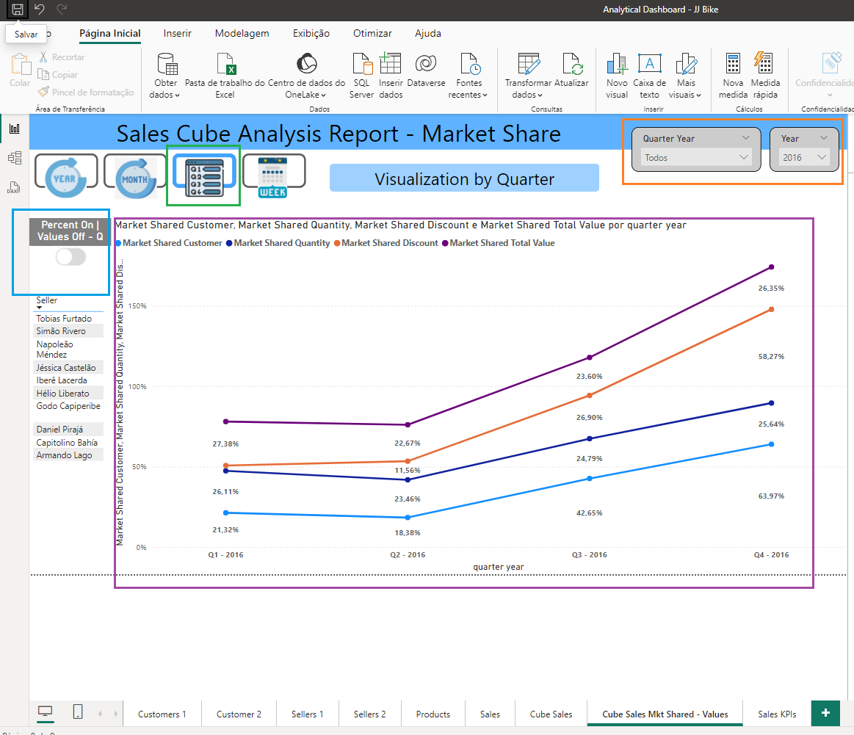
Report : Sales Cube Analysis Report - Market Share - QUARTER
This report follow the same structure the report year , with only one difference is open per Quarter instead by year.
In the green highlight we can see that the currently selected icon is the Quarter View.
In the orange highlight we can see the filters by Quarter and Year.
In the blue highlight we can see the button that takes us to the view of absolute values ​​per Quarter.
This graph shown the Quarter view by market share based on the metrics of market share count by customer, market share quantity, total market share value, and market share discount.

Slide 20
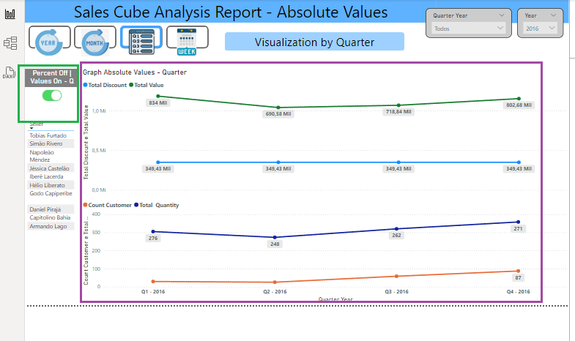
Report : Sales Cube Analysis Report – Absolute Values - QUARTER
This report follow the same structure the report year , with only one difference is open per Quarter instead by year.
In green highlight we can see the button that takes us back to the Quarter view by market share.
In purple highlight, we have a visualization similar to the absolute value visualization by year, with only one single difference, it is opened by Quarter instead of year.

Slide 21
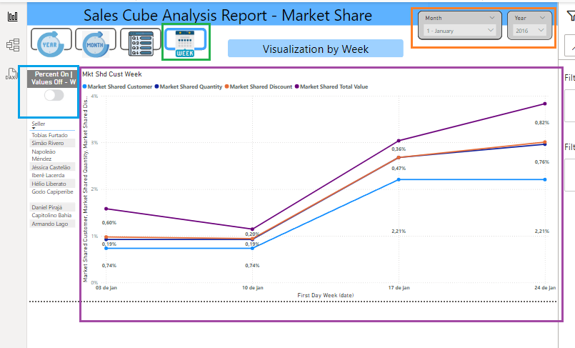
Report : Sales Cube Analysis Report - Market Share - WEEK
This report follow the same structure the report year , with only one difference is open per Week instead by year.
In the green highlight we can see that the currently selected icon is the Week View.
In the orange highlight we can see the filters by Month and Year.
In the blue highlight we can see the button that takes us to the view of absolute values ​​per Week.
This graph shown the Week view by market share based on the metrics of market share count by customer, market share quantity, total market share value, and market share discount.

Slide 22
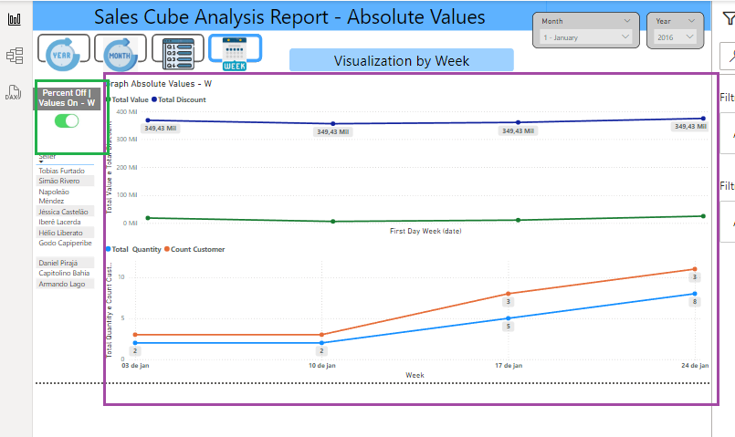
Report : Sales Cube Analysis Report – Absolute Values - WEEK
This report follow the same structure the report year , with only one difference is open per Week instead by year.
In green highlight we can see the button that takes us back to the Week view by market share.
In purple highlight, we have a visualization similar to the absolute value visualization by year, with only one single difference, it is opened by Week instead of year.

Slide 23
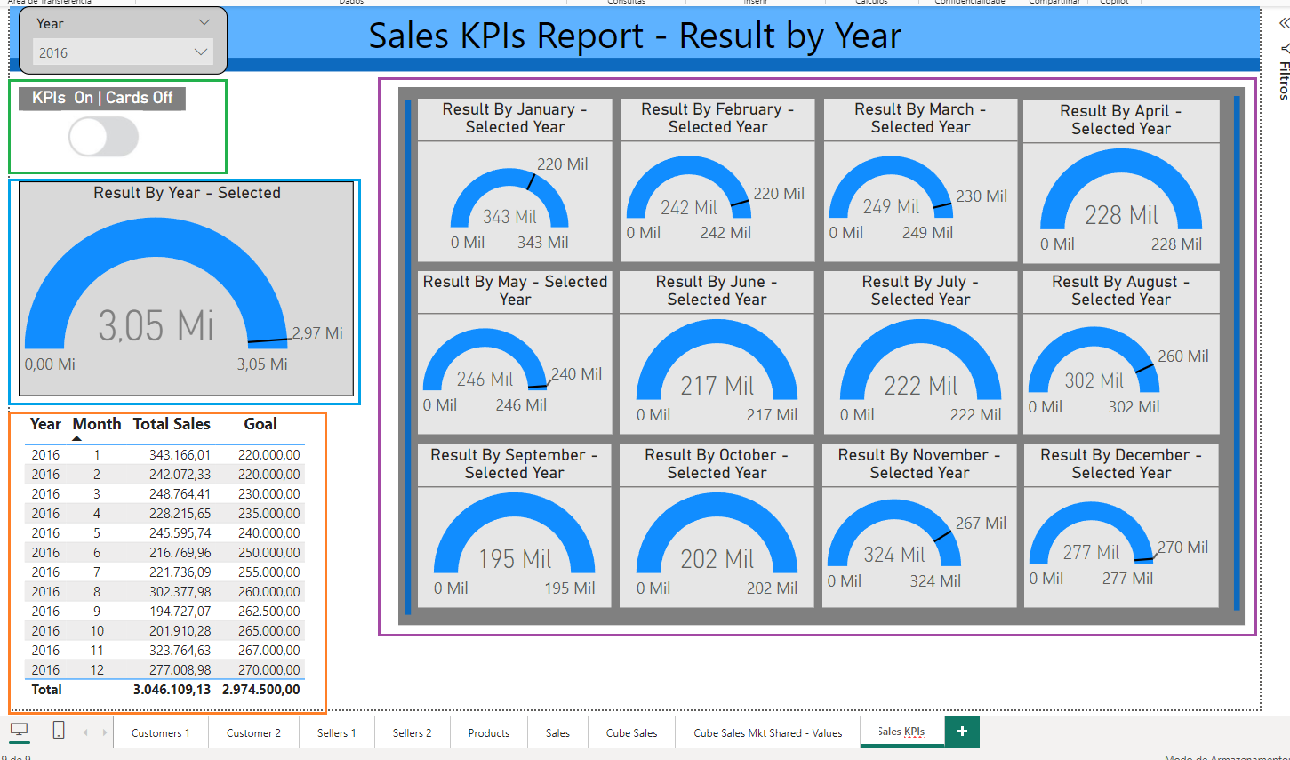
Report : Sales KPIs Report - Result by Year
This is a KPI report on the ninth tab called "Sales KPIs". The report is called "Sales KPIs Report - Result by Year". Based on a table called "Dimensional KPIs", this table is not linked to any other table in the Power BI data model, it was created to be used alone directly in the report, this is a summary table only at the month and year level, it has the result of the sum of the sales value and the sum of the goals per month for each year. This report aims to easily analyze this information visually and measure the sales results in relation to your sales goals.
In green highlight we have the button that gives us access to another view, which allows us to analyze this data using the card's graphs.
In the purple Highlight we can see the Indicator Graph showing the result of the target by value in the black mark and in the blue bar showing the result of the Sales Value, we have 12 kpis one for each month of the year selected in the Year filter
In the blue highlight we have the same information, in the purple highlight with just one difference in this KPI we have the total result for the year selected in the year filter.
In orange we have the table with the information Sum of Total Sales and Target by Month and Year in list form.

Slide 24
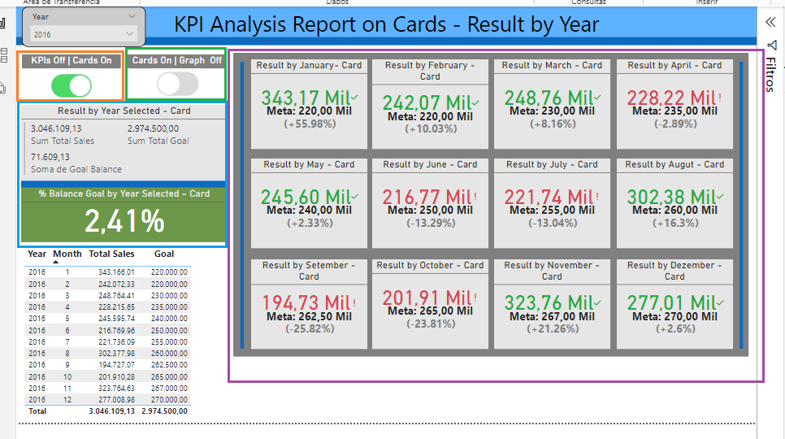
Report : KPI Analysis Report on Cards - Result by Year
This Report continues in the "Sales KPIs" tab and using only the "dimensional KPIs" table, it performs analyses based on the card view.
In Highlighted in orange, we have the button that takes us back to the KPIs View.
In Highlighted in green, we have the button that takes us to another Line Chart Based View.
In blue highlight, we can see the sum of the Total Sales, Total Goal and the result in the Value Goal Balance. This value represents the final result achieved by sales in relation to the total target for the selected year.
The green card with 2.42% represents a positive result in the sales result in relation to the total goal. Note that this is a percentage. The value of this percentage is represented in the Value Goal Balance. If this result is negative, the percentage and the value will be negative and the color of the card will be red.
In purple Hightlight , we have 12 cards, one for each month per year selected in the year filter.
The highest value is the total value of the sum for this month. If it is green, it is because we have reached or exceeded the goal. If it is red, it is because we have not reached the goal for this month.
The middle value is the goal called Meta for this month.
The last value in gray is a percentage of the result of the goals. It can be positive if the goal is reached or exceeded, or negative if the goal is not reached this month. The positive percentage shows how much we have exceeded the goal and the negative percentage shows how much was missing for reaching the goals in the form of a percentage.

Slide 25
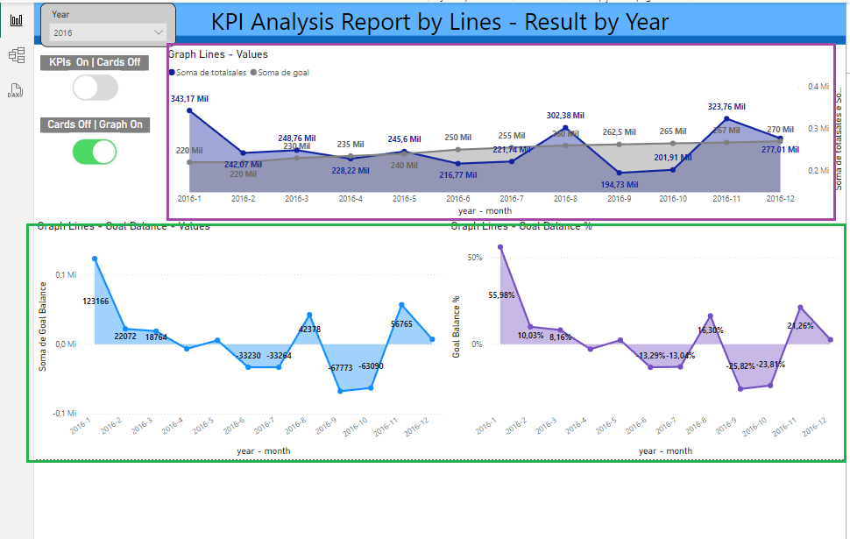
Report : KPI Analysis Report by Lines - Result by Year
This report continues in the "Sales KPIs" tab and using only the "Dimensional KPIs" table, this report has 3 line graphs. The objective is to perform analyses using this data based on time series that will be based on the selected period of the year.
In purple highlight we can see the timeline graph with the metrics Sum of Goal and Total Sales by year-month for the selected year.
In green highlight we can see two line graphs, the first shows the Goal Balance by Value and the second shows the Goal Balance by Percentage, this is the final result according to the selected year.

Slide 26
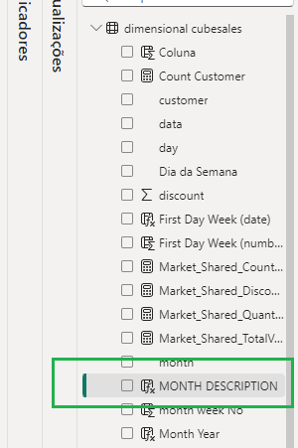
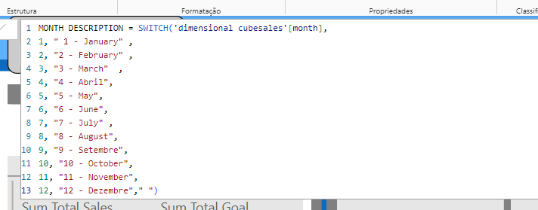
Report : Examples Using Dax In Power BI
Command Switch: This command is used to evaluate each condition in the Month field (1 to 12) and replace the month number with the month description

Slide 27
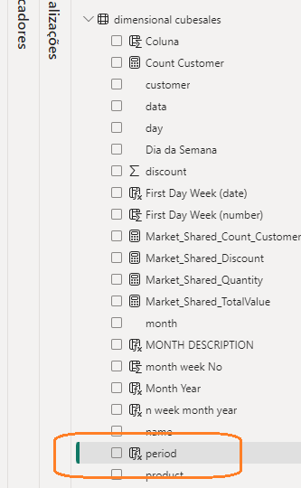
Report : Examples Using Dax In Power BI
Concatenating fields in Dax : In this case we use the & operator which is the same as the AND operator in Programming Logic, we can place the text using " between the characters and add fields from within the Power BI tables and join them into a single field.

Slide 28
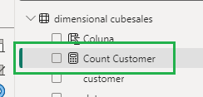
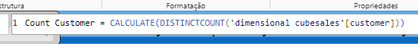
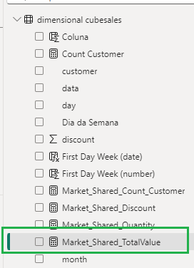
Report : Examples Using Dax In Power BI
command calculate(distincount()) : Used in this case to count the unique quantity of each customer, removing duplicates if they exist
Command divide(field1,field2,0): Here the field1 is a sum of TotalValue, but in this case for each row and SumTotalValue is a sum calculated for the total of the column ignoring all filters.
The result of this calculation shows how much each value in TotalValue participates in relation to the total of this field in the sum of the column, the value represents a percentage value.
The zero at the end of the command means if the calculate brings an error the system will show the value 0 , because when we have one division by zero returns an error in calculate

Slide 29
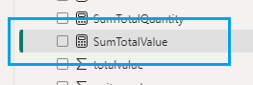
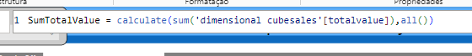
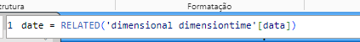
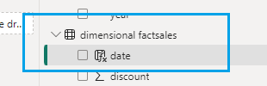
Report : Examples Using Dax In Power BI
Command calculat(sum(field1),all()): In this command a sum of the TotalValue field is made, at the end the all() command, means that all filters will be ignored, it means that this is the sum of the total of all the column, but when creating this new field, we must use new measure and not new column.
Command related(field1): This command is used to bring the field that has a relationship with this table, allow removing all null values ​​from this field, this "date" field comes from the dimensiontime table is a calendar table due to this, the type Relationship allows showing the future date, but without value because it does not have these values ​​in the transactional table, but using this command we solve the null problem without changing the relationship between the tables.

Slide 30
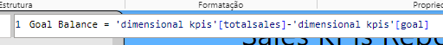
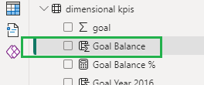
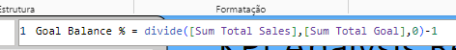
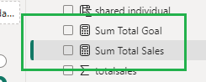
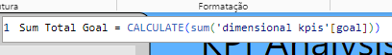
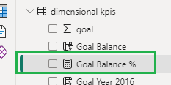
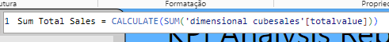
Report : Examples Using Dax In Power BI
Command (field1-field2): In this case we have the subtraction operation using the sum at the end. In this case we take the sales result and subtract it from the target result and obtain the final result, this is a Final Result of the Company or sellers in the selected period. This field was created as a column.
Command divide(field1-field2,0)-1 : In this case we have the division operation using two different fields, the zero in this command means that if the calculation returns an error, the system will replace it with zero.
In this case, field 1 is a value calculated from the sum of the total sales value, the second field is a sum of the total target, when we divide the total sum of sales by the total sum of the target, we have the calculation of the share of sales per target, this is a percentage calculation, the subtraction in command 1, means that the system will subtract the percentage from 100% and give the final result, this means for example that if sales are 120 the target was 100 this result will be 1.20 represents 120%, means that the target was reached and exceeded by 20%, but when we put -1, the balance or final result is obtained, in this case the result will be 20%, it means that 20% of the target was exceeded, if the result is negative it means that it is the final result was lower than the target and the target was not achieved.

Slide 31

Report : Examples Using Linguagem M in Power BI
To access the M language tool, we need to edit the table.
In purple highlight we can see the name of the edited table called "dimension cubesales", the option add new column and add custom column was used to add this new column shown.
In green highlight, this column is a numeric value with the range 0 to 6 representing the day of the week.
In light blue we can see the code for this column, Date.DayOfWeek([date]) this command in M ​​language basically extracts this information from the "data" field this field is a date and time field.

Slide 32

In the purple highlight we can see the command, the first part checks if [Day of the Week] is equal to zero if it is, shows the [data] field, if it is not true leave it blank, in the [Day of the Week] field the number zero represents Sunday and the [data] field is a datetime field that has the date of sale. With this command, a new field shown in blue highlight called "First day of the week (date)" was added In light blue highlight we can see the final result shown in the graph the date of the first day of the week
Report : Examples Using Dax In Power BI

